Slide 1
EU Law for Algorithm
Module:
Labour Law and AI

Slide 2
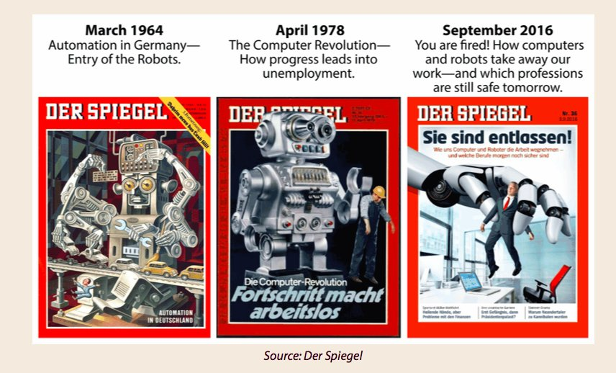
The impact of AI on Work

Slide 3
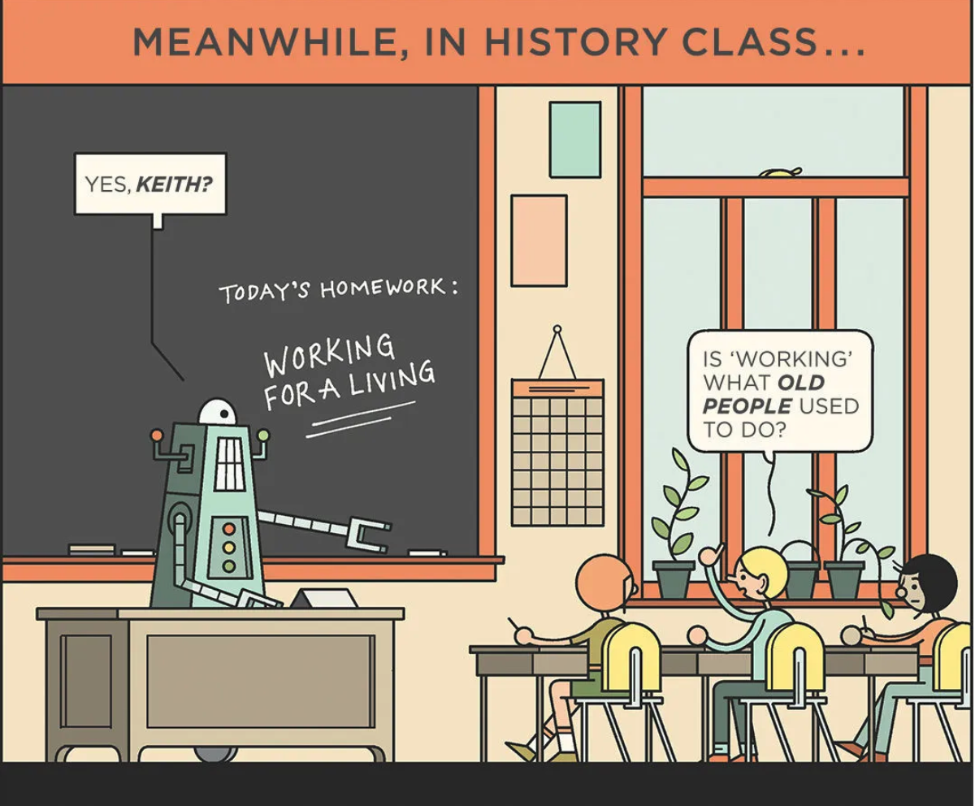
Labour displacement
Algorithmic
Management
Impact on workers’ fundamental rights (dignity, privacy, health and safety) and possible source of bias and discriminations
“47 per cent of total US employment is at risk of automation over some unspecified number of years”
Frey and Osborne (2017)
New Jobs are emerging, other are adapting

Slide 4
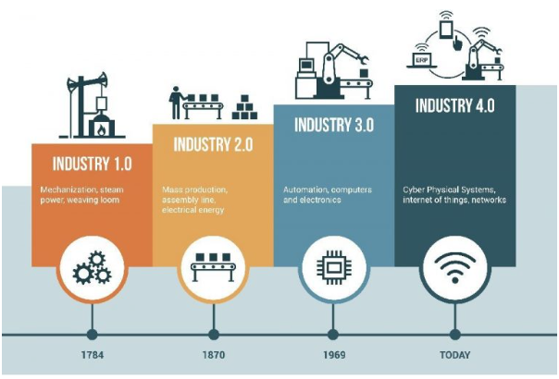
Automation and labour markets
Labour-enabling Increasing labour demand
Labour-replacing
Especially for manual and industrial jobs
Labour-replacing
Also for cognitive and jobs in the service economy
Overestimated risk
–
Lump of labour fallacy
Competition between Humans and Robots
Increasing of bad jobs
(precarious and low paid)

Slide 5
What is this module about?
New work arrangements (platform work, remote work)
Algorithmic management of work relations
How to cope with labour displacement: towards a basic income

Slide 6
Platform Work
Emanuele Menegatti
Professor of Labour Law
e.menegatti@unibo.it

Slide 7
Platform Economy
micro-tasks, highly standardised, repetitive
Online labour platforms
Tasks, often full self-contained projects
Crowdworking
Ride-hailing
Food delivery
63%
On-location labour platforms
Tasks requiring physical delivery of manual services
90%

Slide 8
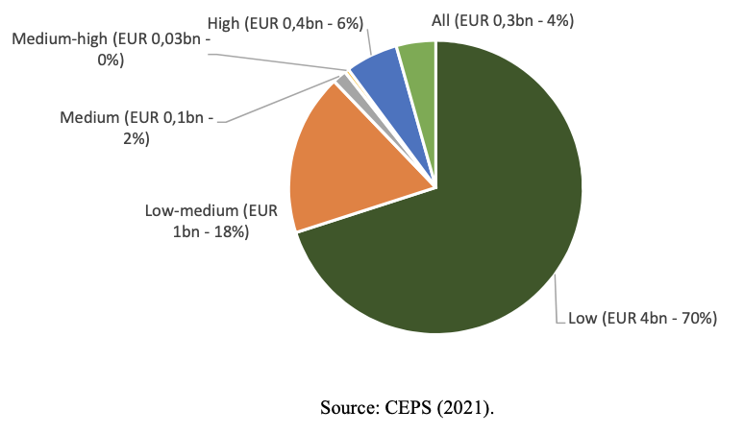
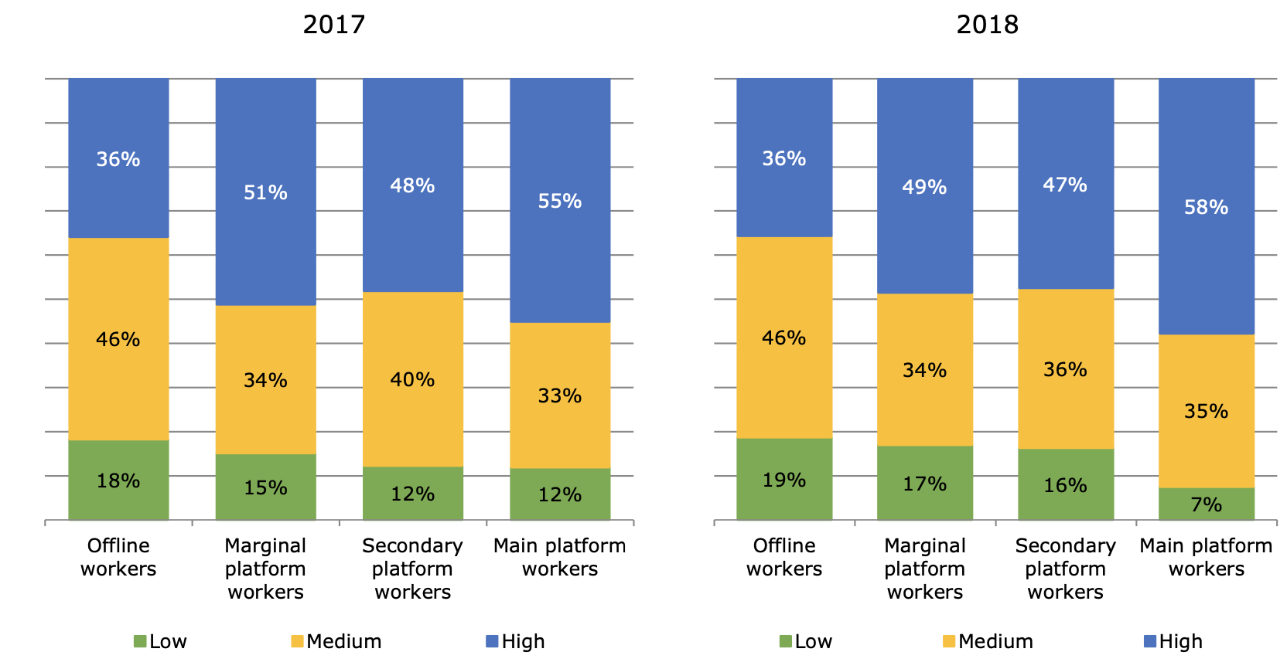
Skills-Mismatch
80%
Low-Skilled
Jobs
Skill level required

Slide 9
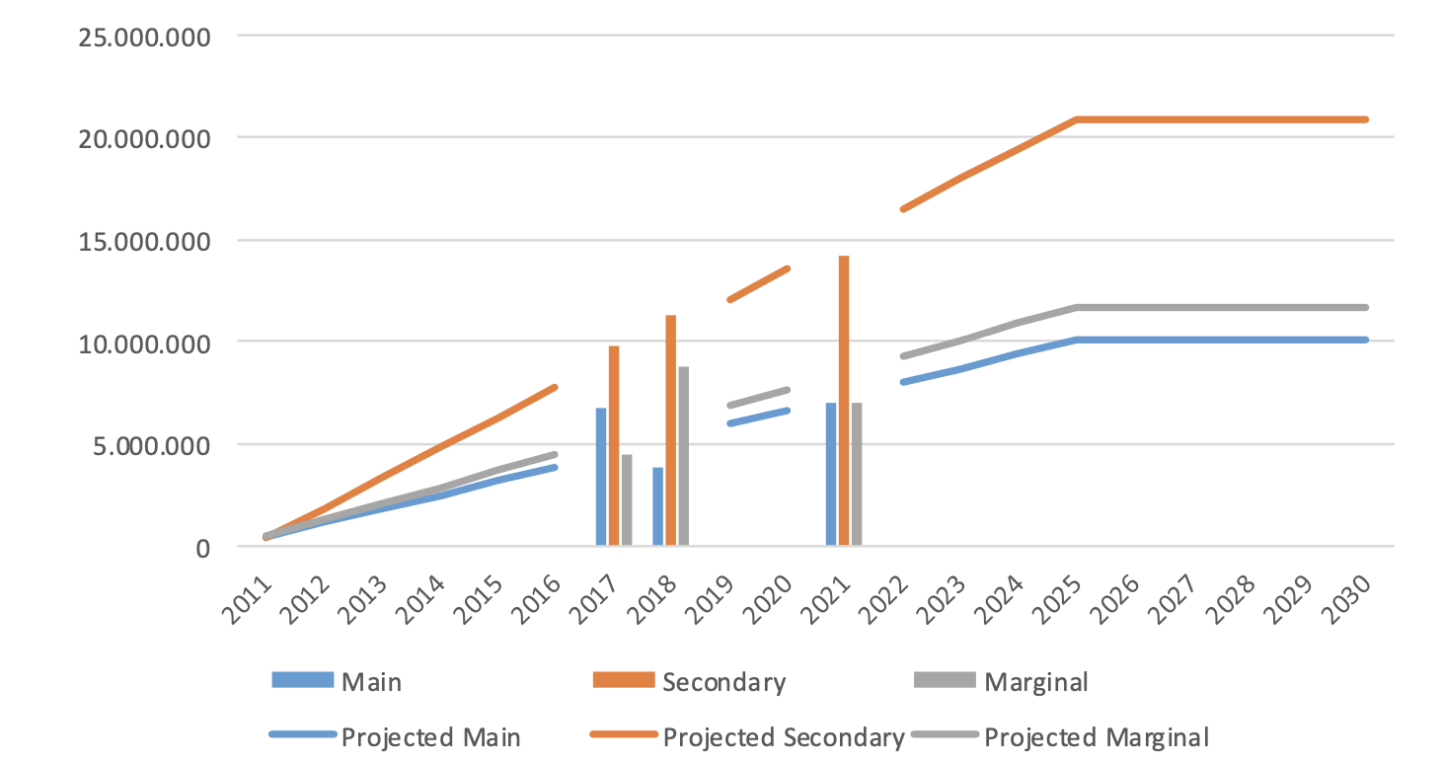
The Size of platform economy in the EU
PLATFORM WORKERS
Main >50% of total income
Secondary 25-50%
Marginal <25%

Slide 10
Work-on-demand via app
1) On-line Platforms connect Consumers and Workers
2) Workers decide if and when to work
Final User
Driver / Rider
(formally)
Independent Contractors
93%
in the EU

Slide 11
Vertically integrated platforms
Non-integrated online platforms
Unilateral determination of fees
Imposition of ‘Quality’ standards (appearance, tools, behaviours)
Influence over work organization (i.e. working time, work modality), including sanctions (i.e. suspension, deactivation)
Supervision by electronic means
No direct contacts with clients
No replacement
- Do not organize work
- Just connect workers with end-users
- Manage some operational and administrative details (i.e. payments)
CONTROL

Slide 12
Classification of Work Relations
Labour Law
Civil law or Commercial law
Self-Employed
Employees
Personal work
No employment rights No collective bargaining (antitrust law applies)
Full Rights
Enterpreneur
Organisation of assets and workers

Slide 13
EMPLOYMENT RELATIONSHIP
Trade-Off
- Retirement schemes
- Unemployment and other benefits
Public welfare
Subordination
Security
Flexibility, reduction of the costs of transaction and coordination
Employers bear costs and liabilities
Employment Protection Legislation
Unpredictable contingencies that might affect workers
Imposed by Trade Unions and Collective Bargaining
H&S
Vicarious and other liabilities

Slide 14
The importance of classification
Decreasing level of employment protection and employment stability
Employee with
special protections
‘Regular’ Employee
Intermediate Category Worker
Indipendent Contractor
+ 10%
0
- 10/20%
- 20/30%
Decreasing Labour Cost

Slide 15
Who is an Employee?

Slide 16
Control Test
Industrial Economy
«the power of deciding the thing to be done, the means to be employed in doing it, the time when and the place where it shall be done»
Ready Mixed Concrete v. Minister for Pensions 1968 (UK)
Direction, monitoring and discipline
Post Industrial Economy
Changing models of work and organisation
Skilled and specialised work
Hierarchy is vanishing
Cooperation and participative management
Management by objectives: Employers are more interested in the result of work (rather in the way to achieve it)
New technologies are making working-time and place less relevant
Autonomy in subordination

Slide 17
Integration test
Control may result from the organization set up by the employer in which the employee is integrated
Organisational framework unilaterally set up by the Employer
Worker
The beneficiary of the work establishes the framework for the execution of the work:
i.e. Working time, place of work, supply of tools and equipment, other organizational behaviours required
Misleading in case of :
Remote-work arrangements, everytime working time and working place are not really relevant

Slide 18
Economic Reality test
NEGATIVE INDICATORS (participation in someone else business)
An employee:
does not employ anyone
no risk of loss (“regular” wage)
no tools, equipment or materials (assets)
no or little investments
no own clientele

Slide 19
Mutuality of Obligations test
Work
Pay
Obligations for:
Employee: make himself available to render the service under direction (or integrated within a business)
Employer: enable the employee to earn his remuneration
Exchange of mutual obligation for future work (indefinite or specified period of time)
Casual engagement
Factual continuity (mere duration) and the expectation to get work to do is not a distinctive feature of “employees”

Slide 20
Pros and Cons of Platform Work
(Potentially) SUCCESFULL BUSINESS MODEL
- Retirement schemes
- Unemployment and other benefits
Public welfare
EMPLOYMENT RELATIONSHIP
Trade-Off
Gig-Work
Control
Security
Employers bear costs and liabilities
Employment Protection Legislation
Unpredictable contingencies that might affect workers
Trade Unions and Collective Bargaining
Health and Safety
Vicarious and other liabilities
…
Work performance:
routes, quality standards, timing, equipment specifications, sanctions
Supervision entailed by rating systems

Slide 21
Lower labour costs
Decreasing level of employment protection and employment stability
Employee with
special protections
‘Regular’ Employee
Intermediate Category Worker
Independent Contractor
+ 10%
0
- 10/20%
- 20/30%
Sustainability of welfare systems
Unfair competition with traditional businesses

Slide 22
CONSUMERS
- Access to more and new services
Main platform workers:
No or little bargaining power
No or little access to labour and social protection
Transparency and predictability of working conditions are not granted
Unpredictable income and low pay
Strong surveillance, risks for data protection and privacy
No collective representation and bargaining
Risks for Health and Safety
Secondary/marginal platform workers:
Reduction of labour market barriers
Creation of new markets
Wider access to consumers
Additional income with low commitment
Algorithmic management and surveillance

Slide 23
ISSUES RELATED TO ALGORITHMIC MANAGEMENT
Surveillance over workers:
Screening of workers personal data and behaviours
Management and control:
Decisions on tasks allocation or sanctions (suspension, deactivation) based on internal metrics and ratings
Efficiency in managing a vast pool of data, workers and users
Direction
Monitoring
Discipline
Implications for:
Workers’ classification
Workers’ rights violation (i.e. discrimination, privacy, health and safety)

Slide 24
CLASSIFICATION DILEMMA
CONTROL
Customer
Worker
Employee or Independent Contractors ?
Access to full employment rights and social security protection

Slide 25
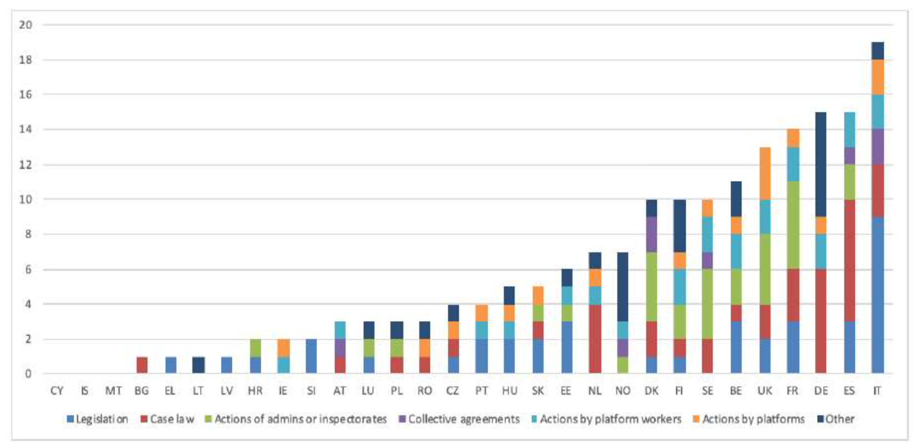
Uneven Member States responses
National initiatives related to platform work

Slide 26
Outcome of legal disputes across Europe
 | SPAIN | FRANCE | ITALY | NETHERLANDS | UK
RIDE-HAILING | I | I E E I E |  |  | W W W
FOOD (and PARCEL) DELIVERY | E E E E E E E E E E E E W W E E | I I E E I I E | I I W E E | I E E | E E E W W I
Trend towards reclassification as “employee”, alongside a better understanding of the phenomenon

Slide 27
Why is an EU action needed ?
Legal uncertainty caused by poor guidance provided by traditional employment tests
Supreme Courts had not the last word
Platforms are adapting their conditions to circumvent decisions and legislations
Positive outcome of lawsuits limited to plaintiffs, limited access to legal actions (arbitration clauses, choice of foreign forums)
Level playing field among Member States and between platforms and traditional service providers

Slide 28
Directive on
‘Improving working conditions in
platform work’

Slide 29
Directive Objectives and Scope
Improve the working conditions of persons performing platform work by:
(1) ensuring their correct employment status and give them access to the applicable labour and social protection rights
(2) promoting transparency, fairness and accountability in algorithmic management in platform work
(3) improving transparency in platform work
Granted to Self-Employed too
Missing: Right to Collective Bargaining for Self-Employed
Online labour platforms
On-location labour platforms
Not including:
Online platforms which do not organise the work
providers of a service whose primary purpose is to exploit or share assets

Slide 30
Tackling Misclassification
MS should introduce procedures to ascertain the existence of an employment relationship
Based on primacy of facts principle
as defined by the law, collective agreements or practice in force in the Member States
with consideration to the case-law of the EU Court of Justice
EU CONCEPT of “WORKER”
“control” is replaced by “coordination” functional to the operation of the business
Mutuality of obligations is not relevant
TRADITIONAL NATIONAL
CONCEPTS of “EMPLOYEE”

Slide 31
Operating in administrative and legal proceedings
Including those involving enforcement authorities
LEGAL PRESUMPTION of employment
The contractual relationship between a digital labour platform that controls the performance of work and a person performing platform work shall be legally presumed to be an employment relationship
Controlling the performance of work may be understood as fulfilling some of the following requirements:
(a) effectively determining the level of remuneration;
(b) requiring the person performing platform work to respect specific binding rules with regard to appearance, conduct towards the recipient of the service or performance of the work;
(c) supervising the performance of work or verifying the quality of the results of the work including by electronic means;
(d) effectively restricting the freedom, including through sanctions, to organise one’s work, in particular the discretion to choose one’s working hours or periods of absence, to accept or to refuse tasks or to use subcontractors or substitutes;
(e) effectively restricting the possibility to build a client base or to perform work for any third party.

Slide 32
Possibility to rebut the legal presumption
1) Platforms should prove
in administrative and/or legal proceedings
the contractual relationship is not an employment relationship
as defined by the law, collective agreements or practice in force in the Member State in question,
with consideration to the case-law of the Court of Justice
2) Platform workers should prove
Platform can be required to assist by providing all relevant information

